Slide 1



STUDYBUZZ
Stay Awake, Stay Sharp!
ROOPAKJEET KAUR
102497013
COPC (4th Sem)
Thapar Institue of Engineering & Technology, Patiala

Slide 2

PROBLEM STATEMENT
Students often study late into the night
Drowsiness and yawning affect focus and learning
No self-monitoring tools during study sessions
01

Slide 3
PROJECT OBJECTIVE
1.
Detect drowsiness via eye closure
2.
Detect yawning via mouth opening
3.
Provide real-time voice alerts to improve focus
02

Slide 4
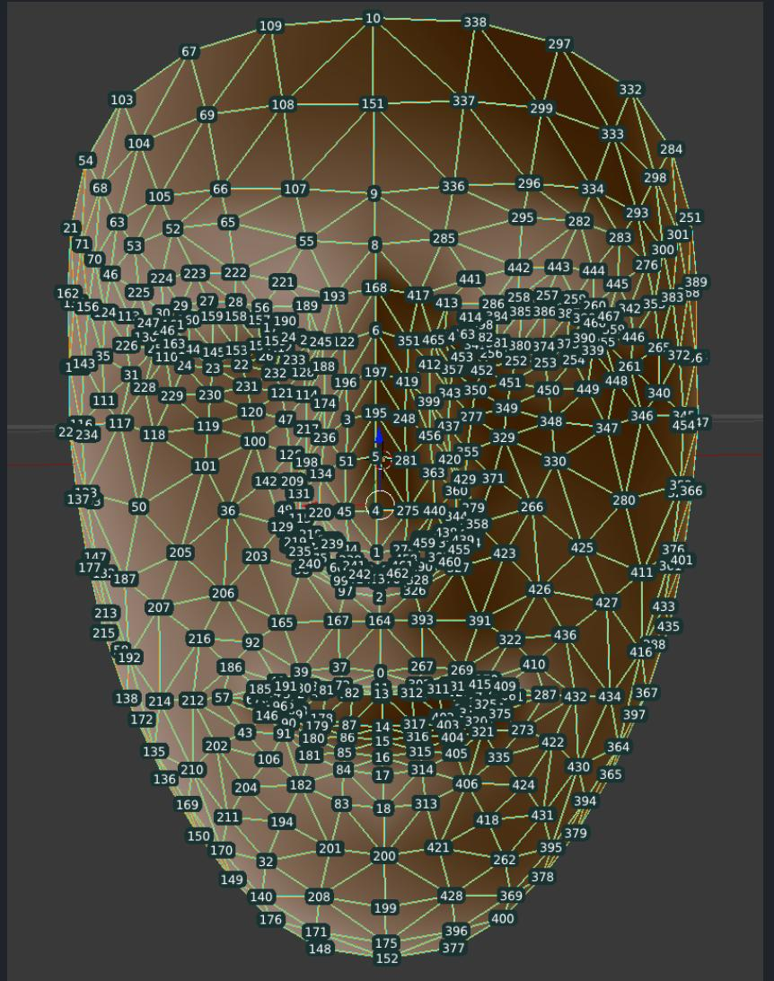
TOOLS &
TECHNOLOGIES
Python 3.7+
OpenCV for real-time video
MediaPipe FaceMesh for facial landmark detection
pyttsx3 for speech alerts
03

Slide 5


SYSTEM ARCHITECTURE
Webcam Input
Captures live video frames of the user.
MediaPipe
FaceMesh
MediaPipe identifies 468 facial landmarks in real-time.
Work
flow
EAR & MAR
Calculation
EAR (Eye Aspect Ratio) and MAR (Mouth Aspect Ratio) are calculated from key landmark points.
Condition Check
If EAR < 0.25 for 2+ seconds → Detected as drowsiness
If MAR > 0.03 → Detected as yawning
Text-to-Speech
Alert
Triggers voice alerts using pyttsx3 (e.g., “Eyes closed! Wake up!”).
04

Slide 6

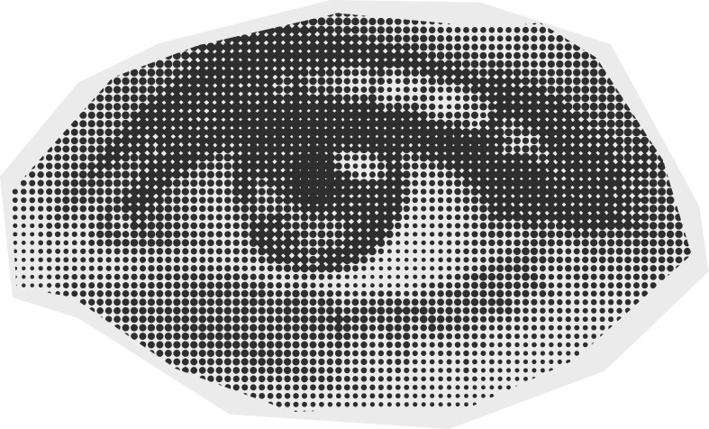
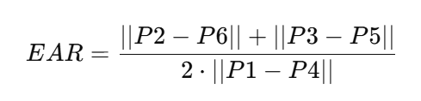
EAR CALCULATION
Eye Aspect Ratio (EAR)
Used to detect eye closure by comparing vertical and horizontal distances between eye landmarks.
Formula:
What it means:
P1, P4 = horizontal eye corners
P2, P6 and P3, P5 = vertical eye points
If EAR drops below a threshold (e.g., 0.25), it indicates the eyes are closing
05

Slide 7
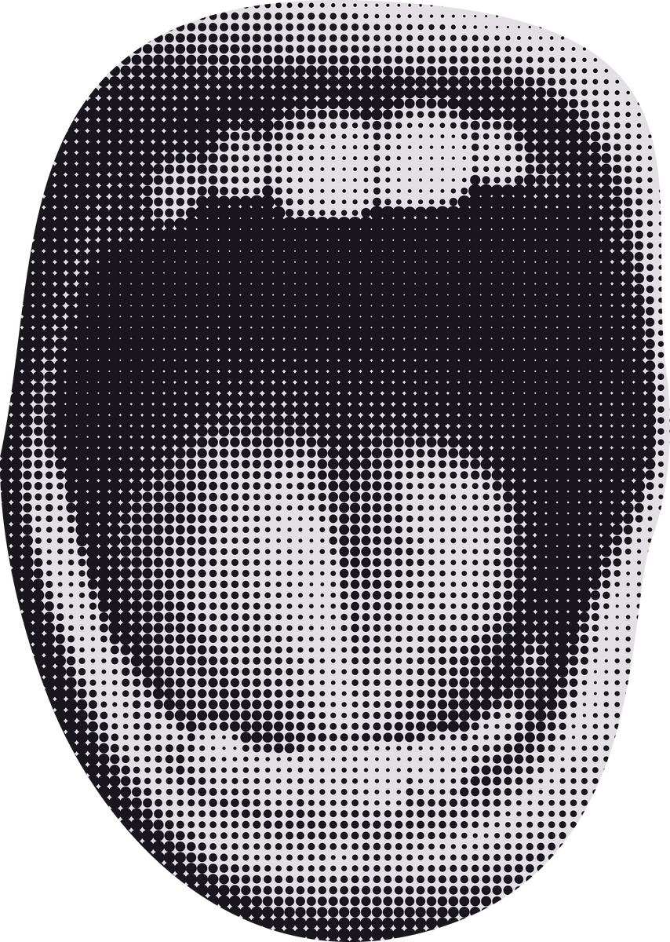
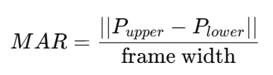
MAR CALCULATION
Mouth Aspect Ratio (MAR)
Used to detect yawning by measuring mouth opening.
Formula:
What it means:
P_upper and P_lower = vertical lip points (e.g., landmarks 13 and 14)
Divided by frame width to normalize across screen sizes
If MAR rises above a threshold (e.g., 0.03), it indicates a yawn
06

Slide 8
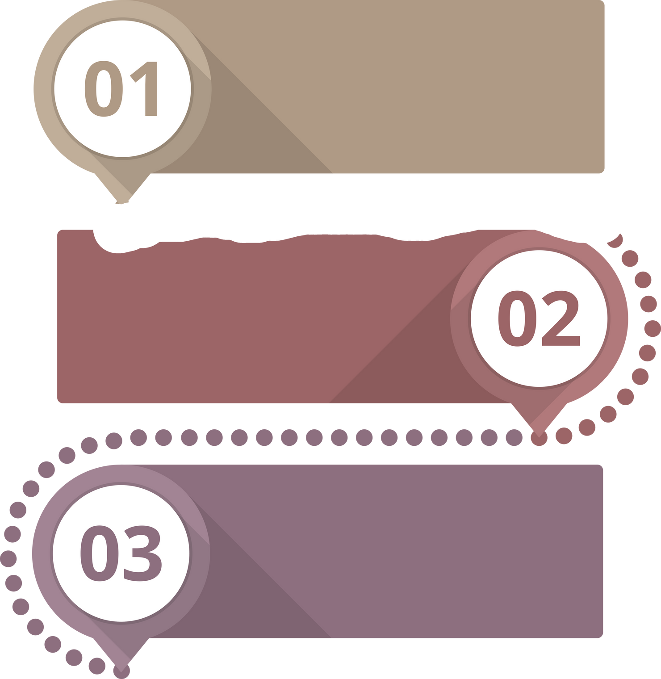
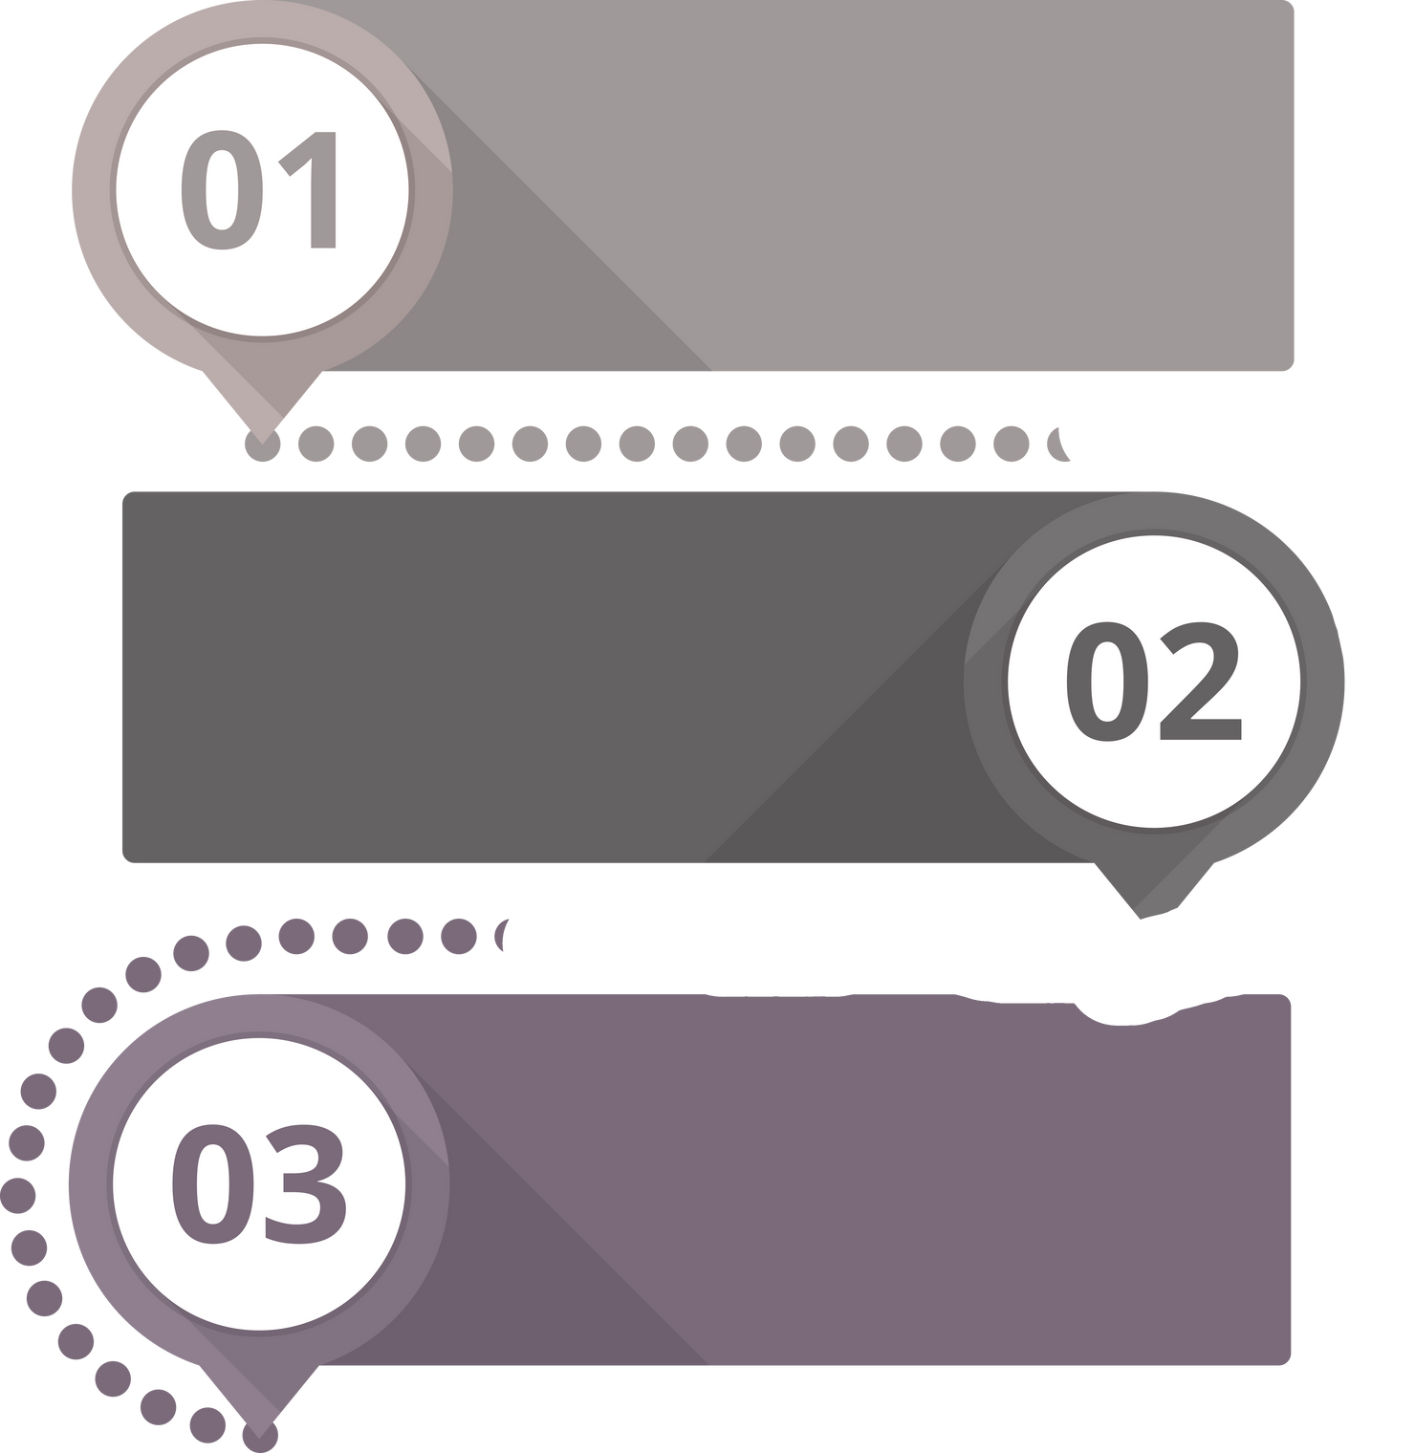

REAL-TIME ALERT FLOW
Continuous Monitoring
Live webcam feed is processed frame-by-frame using OpenCV
Threshold-Based Detection
Alerts are triggered only when detection conditions are met:
EAR < 0.25 (for drowsiness)
MAR > 0.03 (for yawning)
Cooldown Mechanism
A 5-second cooldown timer prevents the same voice alert from being repeated too frequently
Ensures clear and non-disruptive feedback to the user
07

Slide 9
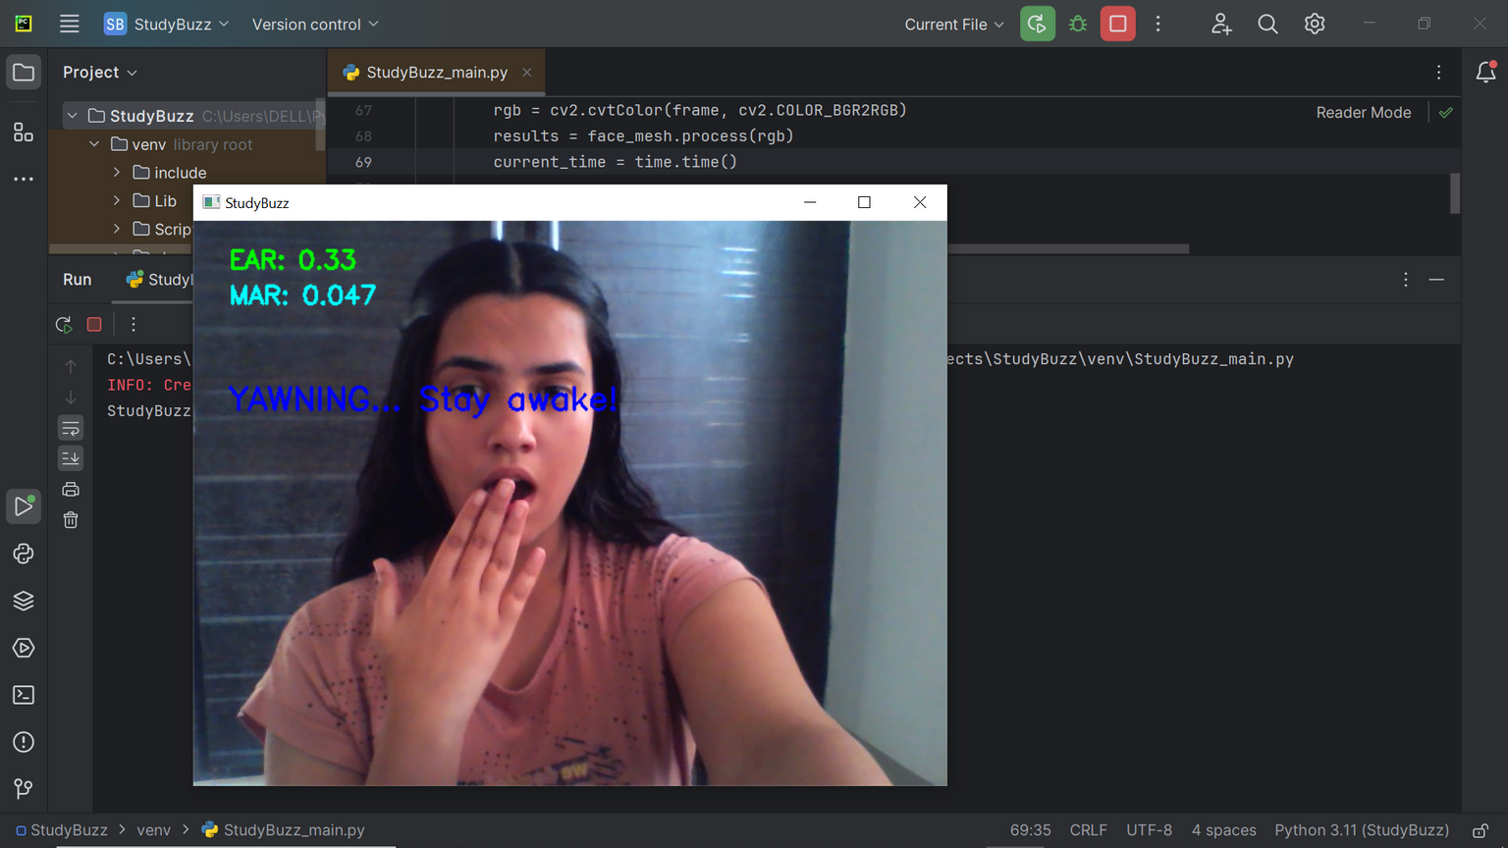
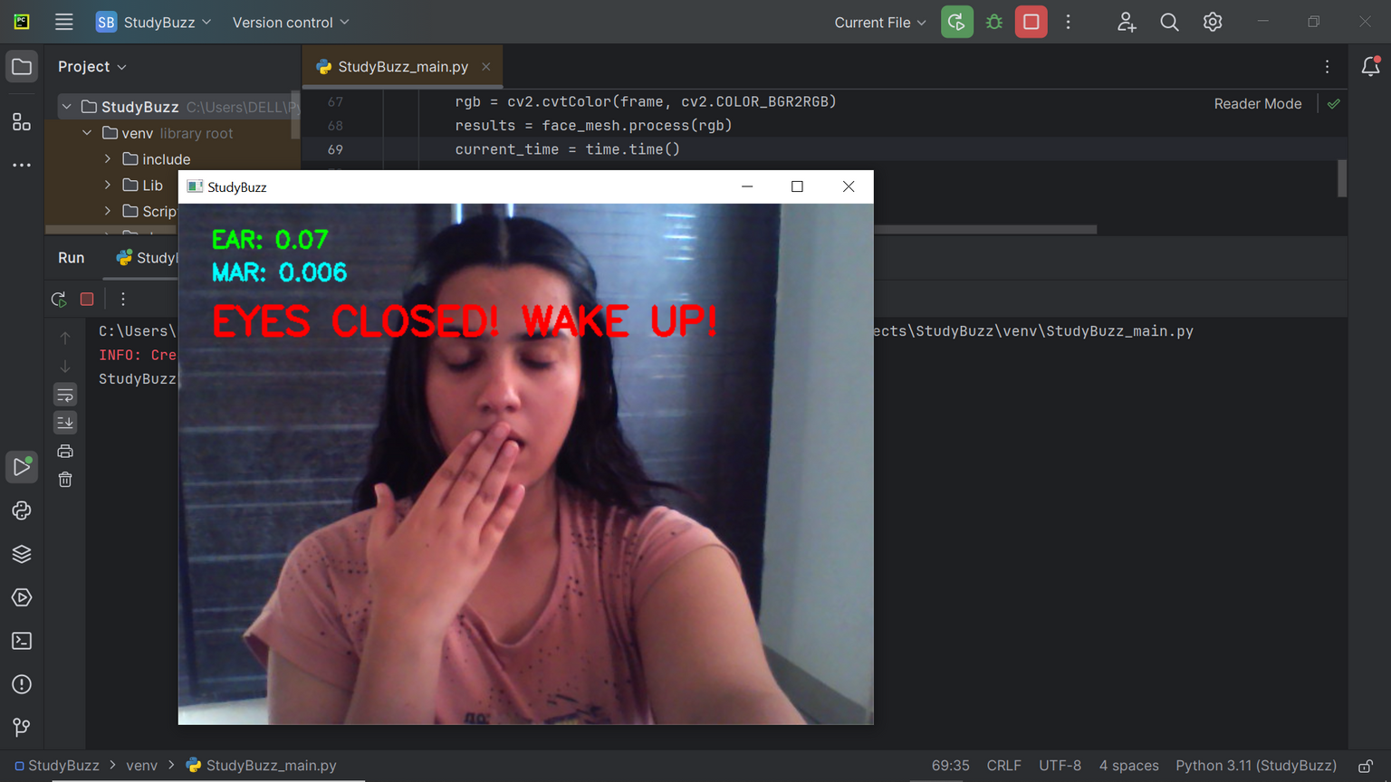
DEMO & OUTPUT
08

Slide 10

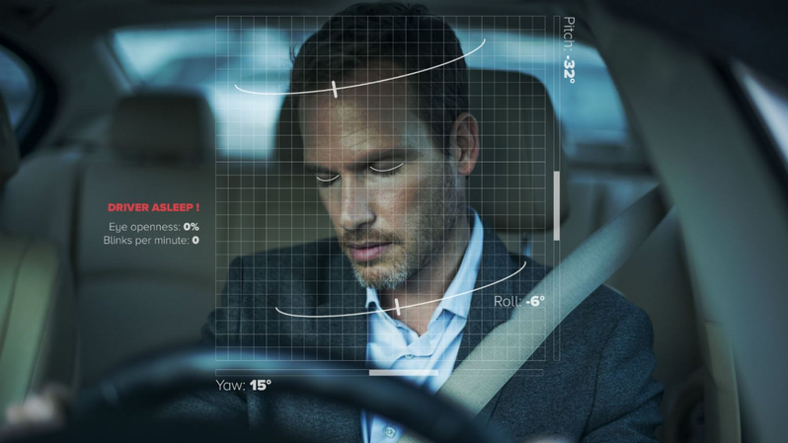
APPLICATIONS
Student Study Assistant
Helps students stay alert during
long or late-night study sessions
Driver Drowsiness Monitor
Can be adapted for drivers to prevent
dozing off behind the wheel
Workplace Productivity Tool
Useful for employees in focus-critical
jobs (e.g., surveillance, coding,
data entry)
09

Slide 11


FUTURE ENHANCEMENTS
Session logging and alert history tracking
Adaptive thresholds based on user calibration
Integration with platforms like Chrome, Zoom, or online learning apps
10

Slide 12
CONCLUSION
StudyBuzzR is a lightweight, real-time computer vision tool designed to improve student focus by detecting drowsiness and yawning.
It uses MediaPipe, OpenCV, and Text-to-Speech (pyttsx3) to deliver instant visual and voice feedback.
The system is fully offline, responsive, and easily extendable to real-world use cases.
11

Slide 13
THANK YOU
12

